Slide 1
Preliminary Investigation
&
Information Gathering
Isaac Tomusange

Slide 2
Fact-finding – the formal process of using research, meetings, interviews, questionnaires, sampling, and other techniques to collect information about system problems, requirements, and preferences. It is also called information gathering or data collection.
4-<number>

Slide 3
Fact-finding Ethics
Fact-Finding often brings systems analysts into contact with sensitive information.
  Company plans
  Employee salaries or medical history
  Customer credit card, social security, or other information
Ethical behavior includes:
  Systems analysts must not misuse that information.
  Systems analysts must protect that information from people who would misuse it.
Otherwise:
  Systems analyst loses respect, credibility, and confidence of users and management, impairing ability to do job
  Organization and systems analyst could have legal liability
  Systems analyst could lose job
4-<number>

Slide 4
Fact – Finding Methods
Sampling (of existing documentation, forms, and databases).
Research and site visits. (Participation)
Observation of the work environment.
Questionnaires.
Interviews.
Prototyping.
JAD/Joint requirements planning (JRP).
4-<number>

Slide 5
Information Gathering: Interactive Methods
Interviews
Joint Application Design (JAD)
Questionnaires
4-<number>

Slide 6
Interviews
Interview - a fact-finding technique whereby the systems analysts collect information from individuals through face-to-face interaction.
  Can be used to:
    Find facts
    Verify facts
    Clarify facts
    Generate enthusiasm
    Get the end-user involved
    Identify requirements
    Solicit ideas and opinions
  Advantages?
  Disadvantages?
The personal interview is generally recognized as the most important and most often used fact-finding technique.
4-<number>

Slide 7
Interviewing
Interviewing is an important method for collecting data on information system requirements.
Interviews reveal information about:
    Interviewee opinions.
    Interviewee feelings.
    About the current state of the system.
    Organizational and personal goals.
    Informal procedures.
4-<number>

Slide 8
Planning the Interview
Five steps in planning the interview are:
  Reading background material.
  Establishing interview objectives.
  Deciding whom to interview.
  Preparing the interviewee.
  Deciding on question types and structure.
4-<number>

Slide 9
Procedure to Conduct an Interview
Select Interviewees
  End users
  Learn about individual prior to the interview
Prepare for the Interview (have a guide)
  An interview guide is a checklist of specific questions the interviewer will ask the interviewee.
Conduct the Interview
  Summarize the problem
  Offer an incentive for participation
  Ask the interviewee for assistance
Follow Up on the Interview
  Memo that summarizes the interview
4-<number>

Slide 10
Interview types
Unstructured interview – an interview that is conducted with only a general goal or subject in mind and with few, if any, specific questions. The interviewer counts on the interviewee to provide a framework and direct the conversation.
Structured interview – an interview in which the interviewer has a specific set of questions to ask of the interviewee.
4-<number>

Slide 11
Question Types
There are two basic types of interview questions:
  Open-ended.
  Closed.
4-<number>

Slide 12

Open-Ended Questions
  Open-ended interview questions allow interviewees to respond how they wish, and to what length they wish.
  Open-ended questions are appropriate when the analyst is interested in breadth and depth of reply.
4-<number>

Slide 13
Advantages of Open-Ended Questions
Eight benefits of open-ended questions are:
  Puts the interviewee at ease.
  Allows the interviewer to pick up on the interviewee's vocabulary.
    Reflect education, values, attitudes, and beliefs.
  Provides richness of detail.
  Reveals avenues of further questioning that may have gone untapped.
4-<number>

Slide 14
Advantages of Open-Ended Questions
Eight Benefits of open-ended questions are: (continued)
  Provides more interest for the interviewee.
  Allows more spontaneity.
  Makes phrasing easier for the interviewer.
  Useful if the interviewer is unprepared.
4-<number>

Slide 15
Disadvantages of Open-Ended Questions
The five drawbacks include:
  May result in too much irrelevant detail.
  Possibly losing control of the interview.
  May take too much time for the amount of useful information gained.
  Potentially seeming that the interviewer is unprepared.
  Possibly giving the impression that the interviewer is on a "fishing expedition”
4-<number>

Slide 16
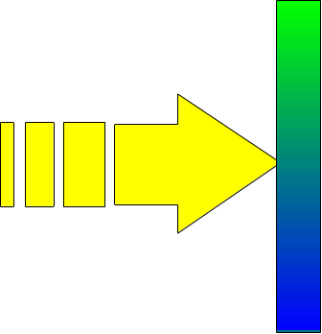
Closed Interview Questions
Closed interview questions limit the number of possible responses.
Closed interview questions are appropriate for generating precise, reliable data that is easy to analyze.
The methodology is efficient, and it requires little skill for interviewers to administer.
4-<number>

Slide 17
Benefits of Closed Interview Questions
Six benefits are:
  Saving interview time.
  Easily comparing interviews.
  Getting to the point.
  Keeping control of the interview.
  Covering a large area quickly.
  Getting to relevant data.
4-<number>

Slide 18
Disadvantages of Closed Interview Questions
Four drawbacks of closed interview questions include:
  Boring for the interviewee.
  Failure to obtain rich detailing.
  Missing main ideas.
  Failing to build rapport between interviewer and interviewee.
4-<number>

Slide 19
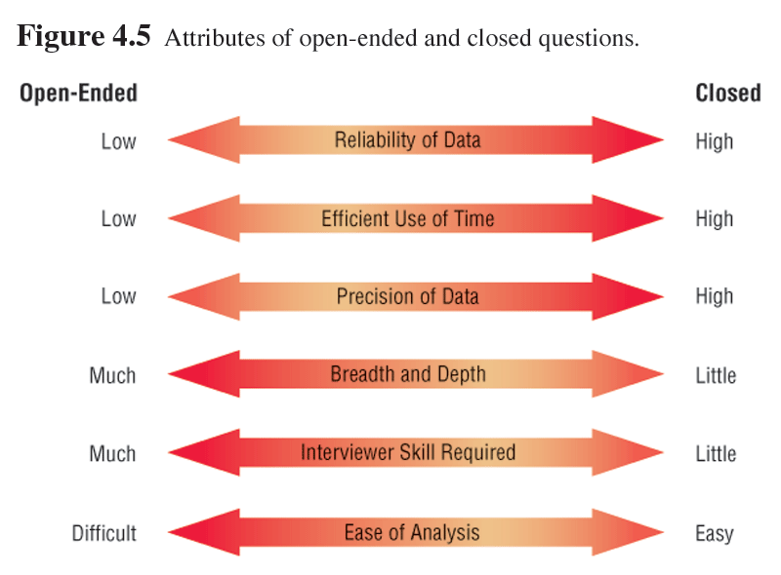
Attributes of Open-ended and Closed Questions
4-<number>

Slide 20
Bipolar Questions
Bipolar questions are those that may be answered with a ‘yes’ or ‘no’ or ‘agree’ or ‘disagree’.
Bipolar questions should be used sparingly.
4-<number>

Slide 21
Interview Question Guidelines
  Use clear and concise language.
  Don’t include your opinion as part of the question.
  Avoid long or complex questions.
  Avoid threatening questions or biased questions.
  Don’t use “you” when you mean a group of people.
4-<number>

Slide 22
Question Sequencing
The three basic ways of structuring interviews are :
  Pyramid, starting with closed questions and working toward open-ended questions.
  Funnel, starting with open-ended questions and working toward closed questions.
  Diamond, starting with closed, moving toward open-ended, and ending with closed questions.
4-<number>

Slide 23

Pyramid Structure
Begins with very detailed, often closed questions
Expands by allowing open-ended questions and more generalized responses
Is useful if interviewees need to be warmed up to the topic or seem reluctant to address the topic
4-<number>

Slide 24

Funnel Structure
Begins with generalized, open-ended questions
Concludes by narrowing the possible responses using closed questions
Provides an easy, nonthreatening way to begin an interview
Is useful when the interviewee feels emotionally about the topic
4-<number>

Slide 25

Diamond Structure
A diamond-shaped structure begins in a very specific way
Then more general issues are examined
Concludes with specific questions
Combines the strength of both the pyramid and funnel structures
Takes longer than the other structures
4-<number>

Slide 26
Closing the Interview
Always ask “Is there anything else that you would like to add?”
Summarize and provide feedback on your impressions.
Ask whom you should talk with next.
Set up any future appointments.
Thank them for their time and shake hands.
4-<number>

Slide 27
Interview Report
Write as soon as possible after the interview.
Provide an initial summary, then more detail.
Review the report with the respondent.
4-<number>

Slide 28
Interviewing Do’s and Don’ts
Do
Be courteous
Listen carefully
Maintain control
Probe
Observe mannerisms and nonverbal communication
Be patient
Keep interviewee at ease
Maintain self-control
Avoid
Continuing an interview unnecessarily.
Assuming an answer is finished or leading nowhere.
Revealing verbal and nonverbal clues.
Using jargon
Revealing your personal biases.
Talking instead of listening.
Assuming anything about the topic and the interviewee.
Tape recording -- a sign of poor listening skills.
4-<number>
Notes:
Teaching Notes
Discuss with the students each of the items and the reasons for their classifications.

Slide 29
Communicating with the User
Guidelines for Communicating
  Look out for non-verbal communication
  Approach the Session with a Positive Attitude
  Set the Other Person at Ease
  Let Them Know You Are Listening
  Don’t Assume Anything
  Ask Questions
  Take Notes
“To hear is to recognize that someone is speaking, to listen is to understand what the speaker wants to communicate.” (Gildersleeve – 1978)
4-<number>

Slide 30
Joint Application Design (JAD)
Joint Application Design (JAD) can replace a series of interviews with the user community.
JAD is a technique that allows the analyst to accomplish requirements analysis and design the user interface with the users in a group setting.
the act of building a small-scale, representative or working model of the users’ requirements in order to discover or verify those requirements.
4-<number>

Slide 31
When to Use JAD
JAD may be used when:
  Users are restless and want something new.
  The organizational culture supports joint problem-solving behaviors.
  Analysts forecast an increase in the number of ideas using JAD.
  Personnel may be absent from their jobs for the length of time required.
4-<number>

Slide 32
JAD Personnel
JAD involves:
  Analysts
  Users
  Executives
  Observers
  Scribe
  Session leader
4-<number>

Slide 33
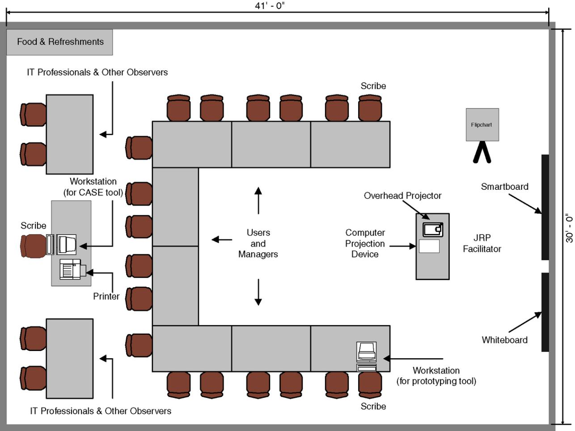
Room Layout for a JPR session
4-<number>
Notes:
Teaching Notes
Discuss the seating arrangement of the participants as well as where the equipment is located. Also solicit the opinions of students in the way of providing refreshments. Do they think it is necessary?

Slide 34
Guidelines for Conducting JRP session:
Do not unreasonably deviate from the agenda
Stay on schedule
Ensure that the scribe is able to take notes
Avoid the use of technical jargon
Apply conflict resolution skills
Allow for ample breaks
Encourage group consensus
Encourage user and management participation without allowing individuals to dominate the session
Make sure that attendees abide by the established ground rules for the session
4-<number>

Slide 35
Benefits of JAD
The potential benefits of using JAD are:
  Time is saved in gathering information (JRP) & in dev’t of the system.
  Rapid development of systems.
  Improved user ownership of the system because of active involvement in dev’t.
  Creative idea production is improved.
4-<number>

Slide 36
Drawbacks of Using JAD
Potential drawbacks of using JAD are:
  JAD requires a large block of time to be available for all session participants.
  If preparation is incomplete, the session may not go very well.
  If the follow-up report is incomplete, the session may not be successful.
  The organizational skills and culture may not be conducive to a JAD session.
4-<number>

Slide 37
Questionnaires
Questionnaire – a special-purpose document that allows the analyst to collect information and opinions from respondents.
  Advantages?
  Disadvantages?
Free-format questionnaire – a questionnaire designed to offer the respondent greater latitude in the answer. A question is asked, and the respondent records the answer in the space provided after the question.
Fixed-format questionnaire – a questionnaire containing questions that require selecting an answer from predefined available responses.
4-<number>
Notes:
Teaching Notes
Have students provide advantages and disadvantages of observation.
Have students provide examples of both free-format and fixed-format questions. The difference between the two is essentially the difference between a multiple-choice and essay exam.

Slide 38
Questionnaires
Questionnaires are useful in gathering information from key organization members about:
  Attitudes.
  Beliefs.
  Behaviors.
  Characteristics.
4-<number>

Slide 39
When to Use Questionnaires
Questionnaires are valuable if:
  Organization members are widely dispersed.
  Many members are involved with the project.
  Exploratory work is needed.
  Problem solving prior to interviews is necessary.
4-<number>

Slide 40
Question Types
Questions are designed as either:
  Open-ended
    Try to anticipate the response you will get.
    Well suited for getting opinions.
  Closed
    Use when all the options may be listed.
    When the options are mutually exclusive.
4-<number>

Slide 41
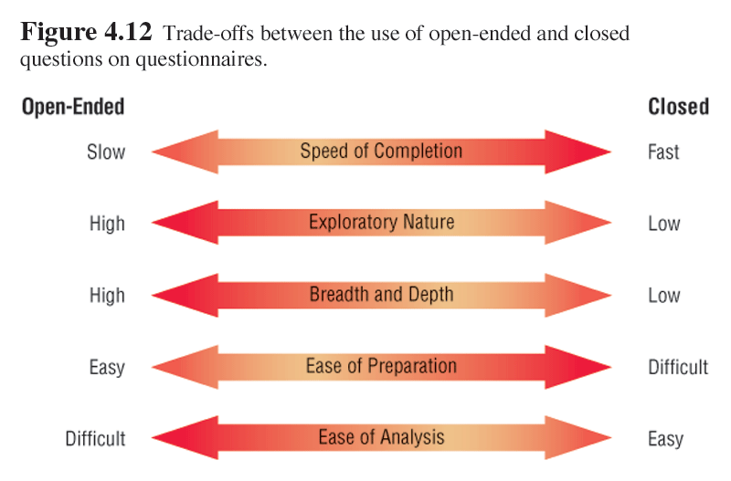
Open-Ended and Closed Questions
4-<number>

Slide 42
Questionnaire Language
Questionnaire language should be:
  Simple.
  Specific.
  Free of bias.
  Not patronizing.
  Technically accurate.
  Addressed to those who are knowledgeable.
  Appropriate for the reading level of the respondent.
4-<number>

Slide 43
Measurement Scales
The two different forms of measurement scales are :
  Nominal.
  Interval.
4-<number>

Slide 44
Nominal Scales
Nominal scales are used to classify things into categories.
It is the weakest form of measurement.
Data may be totaled.
What type of software do you use the most?
1 = Word Processor
2 = Spreadsheet
3 = Database
4 = An Email Program
4-<number>

Slide 45
Interval Scales
An interval scale is used when the intervals are equal.
There is no absolute zero.
Examples of interval scales include the Fahrenheit or centigrade scale.
How useful is the support given by the Technical Support Group?
NOT USEFUL EXTREMELY
AT ALL USEFUL
1 2 3 4 5
4-<number>

Slide 46
Validity and Reliability
Questionnaires must be valid and reliable.
  Reliability of scales refers to consistency in response--getting the same results if the same questionnaire was administered again under the same conditions.
  Validity is the degree to which the question measures what the analyst intends to measure.
4-<number>

Slide 47
Problems with Scales
There are three problems associated with poorly constructed scales:
  Leniency.
  Central tendency.
  Halo effect.
4-<number>

Slide 48
Leniency
Caused by easy raters.
Solution is to move the “average” category to the left or right of center.
4-<number>

Slide 49
Central Tendency
Central tendency occurs when respondents rate everything as average.
Improve by making the differences smaller at the two ends.
Adjust the strength of the descriptors.
Create a scale with more points.
4-<number>

Slide 50
Halo Effect
When the impression formed in one question carries into the next question
Solution is to place one trait and several items on each page.
4-<number>

Slide 51
Developing a Questionnaire
Determine what facts and opinions must be collected and from whom you should get them.
Based on the facts and opinions sought, determine whether free- or fixed-format questions will produce the best answers.
Write the questions.
Test the questions on a small sample of respondents.
Duplicate and distribute the questionnaire.
4-<number>
Notes:
No additional notes.

Slide 52
Designing the Questionnaire
Good response rates can be achieved with consistent control of questionnaire.
  Allow ample white space.
  Allow ample space to write or type in responses.
  Make it easy for respondents to clearly mark their answers.
  Be consistent in style.
4-<number>

Slide 53
Order of Questions
Place most important questions first.
Cluster items of similar content together.
Introduce less controversial questions first.
4-<number>

Slide 54
Web Form Questionnaires
Controls (fields) used on Web forms:
  Single line text box.
  Scrolling text box, used for one or more paragraphs of text.
  Check box for yes-no or true-false answers.
  Radio button for mutually exclusive yes-no or true-false answers.
  Drop-down menu for selection from a list.
  Submit or Clear buttons.
4-<number>

Slide 55
Methods of Administering the Questionnaire
Methods of administering the questionnaire include:
  Convening all concerned respondents together at one time.
  Personally administering the questionnaire.
  Allowing respondents to self-administer the questionnaire.
  Mailing questionnaires.
  Administering over the Web or via email.
4-<number>

Slide 56
Electronically Submitting Questionnaires
Administering a questionnaire electronically has the following benefits:
  Reduced costs.
  Collecting and storing the results electronically.
4-<number>

Slide 57
Information Gathering: Unobtrusive Methods
Sampling
Quantitative document analysis
Qualitative document analysis
Observation
STROBE
Applying STROBE
4-<number>

Slide 58
Sampling
Sampling is a process of systematically selecting representative elements of a population e.g.,
  Organization chart
  Memos and other documents that describe the problem
  Standard operating procedures for current system
  Completed forms
  Manual and computerized screens and reports
  Samples of databases
  Flowcharts and other system documentation
  And more
4-<number>

Slide 59
Sampling
Involves two key decisions:
  Which of the key documents and Web sites should be sampled.
  Which people should be interviewed or sent questionnaires.
4-<number>

Slide 60
Need for Sampling
The reasons systems analysts do sampling are:
  Reducing costs.
  Speeding up the data-gathering process.
  Improving effectiveness.
  Reducing data-gathering bias.
4-<number>

Slide 61
Sampling Design Steps
To design a good sample, a systems analyst needs to follow four steps:
  Determining the data to be collected or described.
  Determining the population to be sampled.
  Choosing the type of sample.
  Deciding on the sample size.
4-<number>

Slide 62
Sample Size
The sample size decision should be made according to the specific conditions under which a systems analysts works with such as:
  Sampling data on attributes.
  Sampling data on variables.
  Sampling qualitative data.
4-<number>

Slide 63
Types of Sampling
The four types of sampling are:
  Convenience.
  Purposive.
  Simple random.
  Complex random.
4-<number>

Slide 64
Convenience Sampling
Unrestricted, non probability samples
Easy to arrange
Most unreliable
4-<number>

Slide 65
Purposive Sampling
Based on judgment. Analyst chooses group of individuals to sample Based on criteria.
Non probability sample
Moderately reliable
4-<number>

Slide 66
Simple Random Sampling
Based on a numbered list of the population
Each person or document has an equal chance of being selected
4-<number>

Slide 67
Complex Random Sampling
The three forms are:
  Systematic sampling.
  Stratified sampling.
  Cluster sampling.
4-<number>

Slide 68
Systematic Sampling
Simplest method of probability sampling
Choose every kth person on a list
Not good if the list is ordered
4-<number>

Slide 69
Stratified Sampling
Stratification is the process of :
Identifying subpopulations or strata
Selecting objects or people for sampling from the subpopulation
Compensating for a disproportionate number of employees from a certain group
Selecting different methods to collect data from different subgroups.
Most important to the systems analyst
4-<number>

Slide 70
Cluster Sampling
Select group of documents or people to study.
Select typical groups that represent the remaining ones.
4-<number>

Slide 71
Hard Data
In addition to sampling, investigation of hard data is another effective method for systems analysts to gather information.
4-<number>

Slide 72
Obtaining Hard Data
Hard data can be obtained by:
  Analyzing quantitative documents such as records used for decision making.
  Performance reports.
  Records.
  Data capture forms.
  Ecommerce and other transactions.
4-<number>

Slide 73
Qualitative Documents
Examine qualitative documents for the following:
  Key or guiding metaphors.
  Insiders vs. outsiders mentality.
  What is considered good vs. evil.
  Graphics, logos, and icons in common areas or Web pages.
  A sense of humor.
4-<number>

Slide 74
Analyzing Qualitative Documents
Qualitative documents include:
  Memos.
  Signs on bulletin boards.
  Corporate Web sites.
  Manuals.
  Policy handbooks.
4-<number>

Slide 75
Observation
Observation – a fact-finding technique wherein the systems analyst either participates in or watches a person perform activities to learn about the system.
  Advantages?
  Disadvantages?
Work sampling - a fact-finding technique that involves a large number of observations taken at random intervals.
4-<number>
Notes:
Teaching Notes
This technique is often used when the validity of data collected through other methods is in question or when the complexity of certain aspects of the system prevents a clear explanation by the end-users.
Have students review The Railroad Paradox by Gerald M. Weinberg. Discuss the moral of the story.
Have students provide advantages and disadvantages of observation.

Slide 76
Observation
Observation provides insight on what organizational members actually do.
See firsthand the relationships that exist between decision makers and other organizational members.
4-<number>

Slide 77
Analyst’s Play script
Involves observing the decision-makers behavior and recording their actions using a series of action verbs
Examples:
  Talking.
  Sampling.
  Corresponding.
  Deciding.
4-<number>

Slide 78
STROBE
STRuctured OBservation of the Environment-- a technique for observing the decision maker's environment
4-<number>

Slide 79
STROBE Elements
Analyzes seven environmental elements:
  Office location.
  Desk placement.
  Stationary equipment.
  Props.
  External information sources.
  Office lighting and color.
  Clothing worn by decision makers.
4-<number>

Slide 80
Office Location
Accessible offices
  Main corridors, open door
  Major traffic flow area
  Increase interaction frequency and informal messages
Inaccessible offices
  May view the organization differently
  Drift apart from others in objectives
4-<number>

Slide 81
Desk Placement
Visitors in a tight space, back to wall, large expanse behind desk
  Indicates maximum power position
Desk facing the wall, chair at side
  Encourages participation
  Equal exchanges
4-<number>

Slide 82
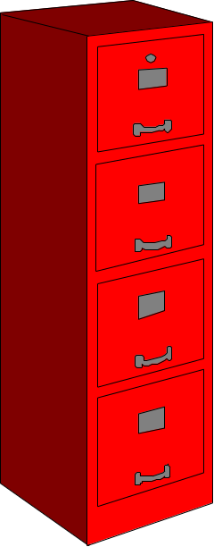
Stationary Office Equipment
File cabinets and bookshelves:
If not present, person stores few items of information personally.
If an abundance, person stores and values information.
4-<number>

Slide 83

Props
Calculators
Personal computers
Pens, pencils, and rulers
If present, person processes data personally
4-<number>

Slide 84

External Information Sources
Trade journals or newspapers indicate the person values outside information.
Company reports, memos, policy handbooks indicate the person values internal information.
4-<number>

Slide 85
Office Lighting and Color
Warm, incandescent lighting indicates:
  A tendency toward more personal communication.
  More informal communication.
Brightly lit, bright colors indicate:
  More formal communications (memos, reports).
4-<number>

Slide 86
Clothing
Male
  Formal two piece suit - maximum authority
  Casual dressing (sport jacket/slacks) - more participative decision making
Female
  Skirted suit - maximum authority
4-<number>

Slide 87
Anecdotal List with Symbols
The five symbols used to evaluate how observation of the elements of STROBE compared with interview results are:
  A checkmark, the narrative is confirmed.
  An “X” means the narrative is reversed.
  An oval or eye-shaped symbol serves as a cue to look further.
  A square means observation modifies the narrative.
  A circle means narrative is supplemented by observation.
4-<number>

Slide 88
Observation Guidelines
Determine the who, what, where, when, why, & how of the observation.
Obtain permission from appropriate supervisors/ managers.
Inform those who will be observed of the purpose of the observation.
Keep a low profile.
Take notes during /immediately following the observation.
Review observation notes with appropriate individuals.
Don't interrupt the individuals at work.
Don't focus heavily on trivial activities.
Don't make assumptions.
4-<number>
Notes:
No additional notes.

Slide 89
Information Gathering:
Prototyping, RAD, & XP
Prototyping
Rapid application development (RAD)
Extreme Programming (XP)
4-<number>

Slide 90
Prototyping
Prototyping is an information-gathering technique.
Prototypes are useful in seeking user reactions, suggestions, innovations, and revision plans.
Prototyping may be used as an alternative to the systems development life cycle.
4-<number>

Slide 91
Prototyping As an Alternative to the Systems Life Cycle
Two main problems with the SDLC:
  Extended time required to go through the development life cycle.
  User requirements change over time.
  Prototyping may be used as an alternative.
4-<number>

Slide 92
Prototype Development Guidelines
Guidelines for developing a prototype are:
  Work in manageable modules.
  Build the prototype rapidly.
  Modify the prototype in successive iterations.
  Stress the user interface.
4-<number>

Slide 93
Prototype Disadvantages
Managing the prototyping process is difficult because of its rapid, iterative nature.
Incomplete prototypes may be regarded as complete systems.
4-<number>

Slide 94
Prototype Advantages
Potential for changing the system early in its development
Opportunity to stop development on an unworkable system
Possibility of developing a system that closely addresses users needs and expectations
4-<number>

Slide 95
Prototype Evaluation – The User’s Role
The user’s role is honest involvement.
Three ways the user is involved:
  Experimenting with the prototype.
  Giving open reactions to the prototype.
  Suggesting additions to and/or deletions from the prototype.
4-<number>

Slide 96
Rapid Application Development (RAD)
RAD, or rapid application development, is an object-oriented approach to systems development that includes a method of development as well as software tools.
4-<number>

Slide 97
RAD Phases
The three broad phases to RAD are :
  Requirements planning.
  RAD design workshop.
  Implementation.
4-<number>

Slide 98
Requirements Planning Phase
Users and analysts meet to identify objectives of the application or system
Oriented toward solving business problems
4-<number>

Slide 99
RAD Design Workshop
  Design and refine phase.
  Use group decision support systems to help users agree on designs.
  Programmers and analysts can build and show visual representations of the designs and workflow to users.
  Users respond to actual working prototypes.
  Analysts refine designed modules based on user responses.
4-<number>

Slide 100
Implementation Phase
As the systems are built and refined, the new systems or partial systems are tested and introduced to the organization.
When creating new systems, there is no need to run old systems in parallel.
4-<number>

Slide 101
Martin Approach to RAD
The Martin approach to RAD includes four phases:
  Requirements planning.
  User design.
  Construction.
  Cutover.
4-<number>

Slide 102
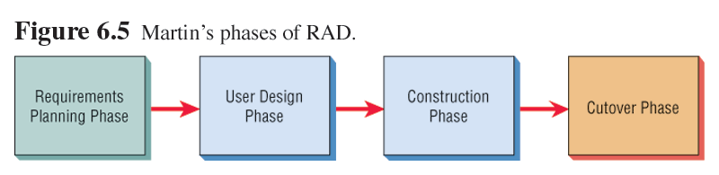
Martin Approach to RAD
4-<number>

Slide 103
RAD and the SDLC
RAD tools are used to generate screens and exhibit the overall flow of the application.
Users approve the design and sign off on the visual model.
Implementation is less stressful because users helped to design the business aspects of the system.
4-<number>

Slide 104
When to Use RAD
RAD is used when:
  The team includes programmers and analysts who are experienced with it.
  There are pressing reasons for speeding up application development.
  The project involves a novel ecommerce application and needs quick results.
  Users are sophisticated and highly engaged with the goals of the company.
4-<number>

Slide 105
Disadvantages of RAD
May try and hurry the project too much
Loosely documented
4-<number>

Slide 106
Extreme Programming (XP)
Extreme programming (XP) takes good systems development practices to the extreme.
4-<number>

Slide 107
Four Values of Extreme Programming
The four values of extreme programming are:
  Communication.
  Simplicity.
  Feedback.
  Courage.
4-<number>

Slide 108
Five XP Principles
The five XP principles are:
  Providing rapid feedback.
  Assuming simplicity.
  Changing incrementally.
  Embracing change.
  Encouraging quality work.
4-<number>

Slide 109
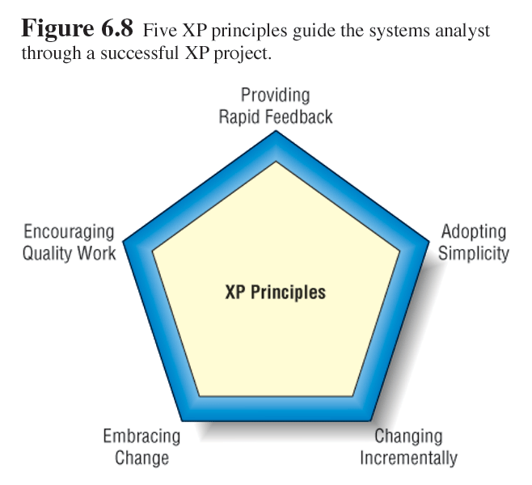
Five XP Principles
4-<number>

Slide 110
Four Basic Activities of XP
The four basic activities of XP are:
  Coding.
  Testing.
  Listening, to the programming partner and customer.
  Designing.
4-<number>

Slide 111
Four XP Resource Control Variables
The four resource control variables in XP are:
  Time.
  Cost.
  Scope.
  Quality.
4-<number>

Slide 112
Four XP Core Practices
The four XP core practices are:
  Short releases, work with the most important features first.
  Having a 40-hour work week.
  Having an onsite customer.
  Pair programming with another programmer.
4-<number>

Slide 113
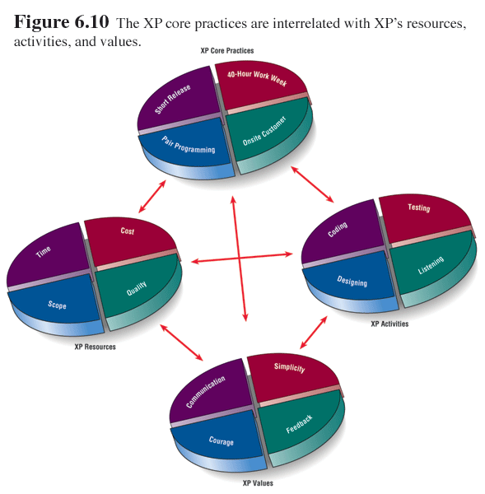
XP Relationships
4-<number>

Slide 114
XP Development Process
The phases of the XP development process are:
  Exploration.
  Planning.
  Iterations to the first release.
  Productionizing.
  Maintenance.
4-<number>

Slide 115
XP Stories
XP stories are a spoken interaction between developers and users.
It is not written communication.
The goal is prevention of misunderstanding or misinterpretations of user requirements.
4-<number>

Slide 116
XP Lessons
The six lessons that can be drawn from the XP development approach are:
  Short releases allow the system to evolve.
  Pair programming enhances overall quality.
  Onsite customers are mutually beneficial to the business and the XP team.
4-<number>

Slide 117
XP Lessons
The six lessons that can be drawn from the XP development approach (continued)
The 40-hour work week improves worker effectiveness.
Balanced resources and activities support project goals.
XP values are crucial to success.
4-<number>

Slide 118
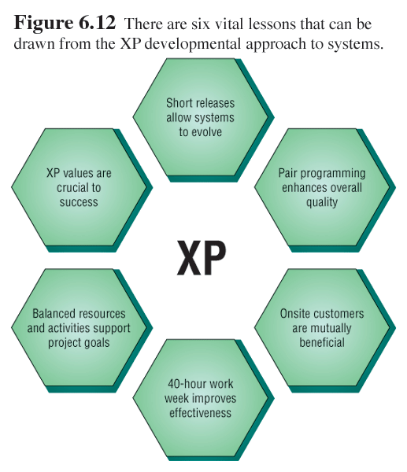
XP Lessons
4-<number>

